Slide 1
ONLINE VOTING SYSTEM

Slide 2
Introduction
The Online Voting System is a web-based application designed to conduct elections electronically.
It enables registered voters to cast their votes securely from any location.
The system reduces manual effort, voting time, and paperwork involved in traditional elections.

Slide 3
Overview of the Project
The project provides a secure and user-friendly platform for conducting elections online.
It manages voter registration, candidate information, and vote casting efficiently.
The system prevents duplicate voting and maintains data integrity.
Election results are generated automatically and accurately after voting ends.

Slide 4
System Requirements Specification
Functional Requirements
User registration
Voter authentication
Candidate display
Secure vote storage
Result generation
Non-Functional Requirements
High security
System reliability
Fast response
User-friendly interface
High scalability

Slide 5
Problem Analysis
Draw of the Existing System
The existing voting system requires manual processes, which consume more time.
Vote counting is slow and may lead to human errors.
Managing voters and ballots involves high operational cost.

Slide 6
What to Achieve in the New System
The new system aims to provide a secure and reliable online voting platform.
It ensures faster vote counting with accurate and tamper-proof results.
The system improves accessibility, transparency, and overall election efficiency.

Slide 7
Scope and Objectives of the Project
Develop a secure and user-friendly online voting system for registered voters.
Enable administrators to efficiently manage elections, candidates, and voter information.
Ensure accurate, real-time vote counting and transparent result generation.
Maintain data security, privacy, and integrity throughout the voting process.

Slide 8
Identifications
Use Cases
Actors
    User Registration
    Login / Authentication
    Cast Vote
    View Election Results
    Manage Voters
    Manage Candidates
    Create and Monitor Elections
Voter
Administrator

Slide 9
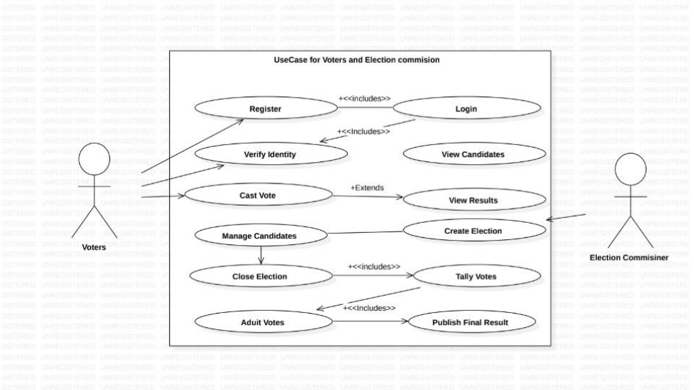
UML Design
Use Case Diagram

Slide 10
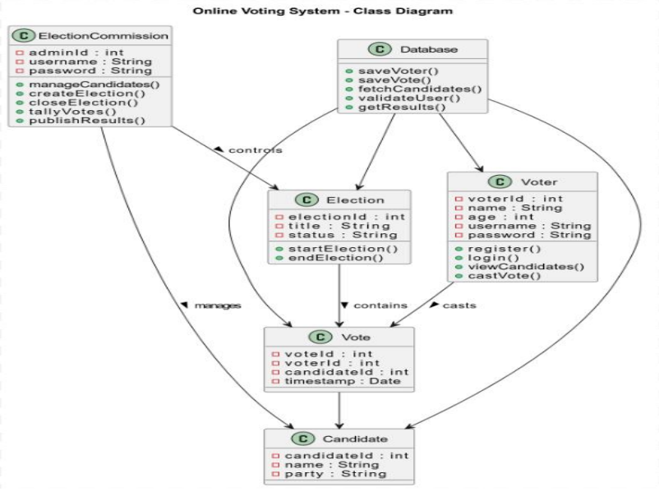
Class Diagram

Slide 11
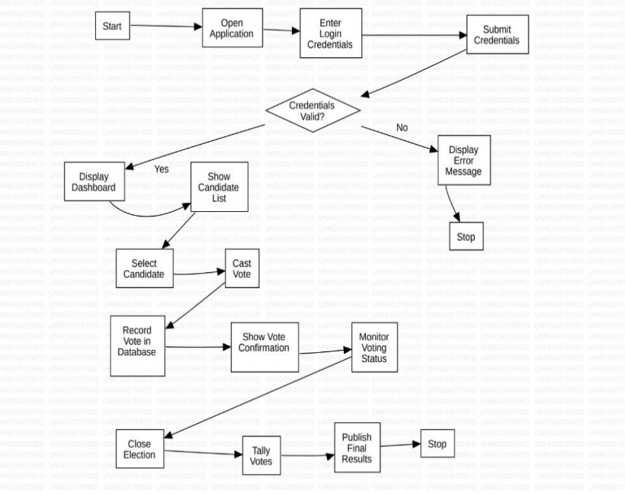
Activity Diagram

Slide 12
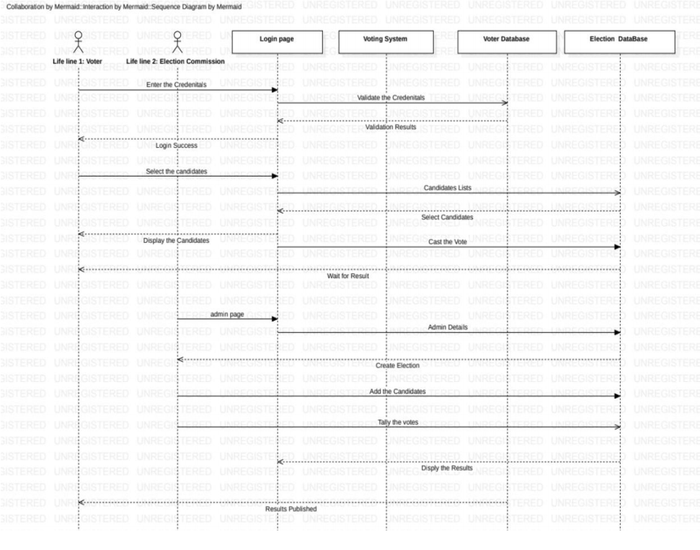
Sequence Diagram

Slide 13
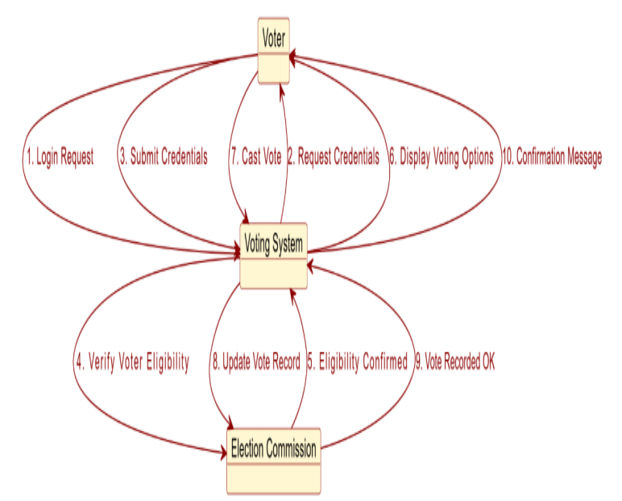
Collaboration Diagram

Slide 14
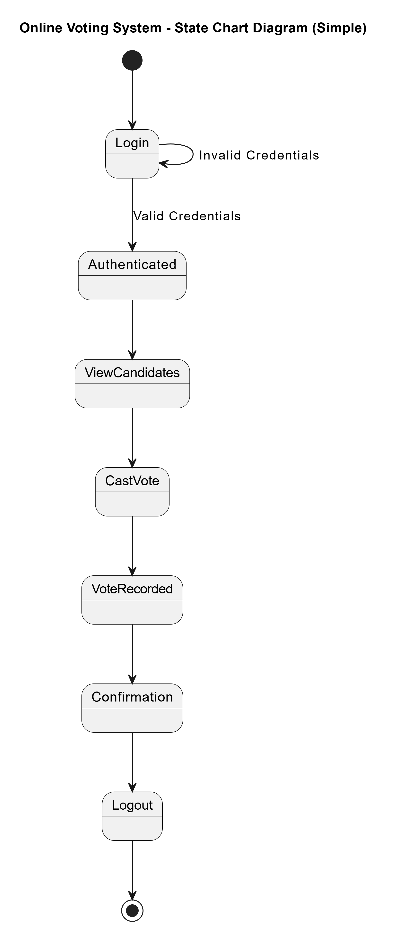
State Chart Diagram

Slide 15
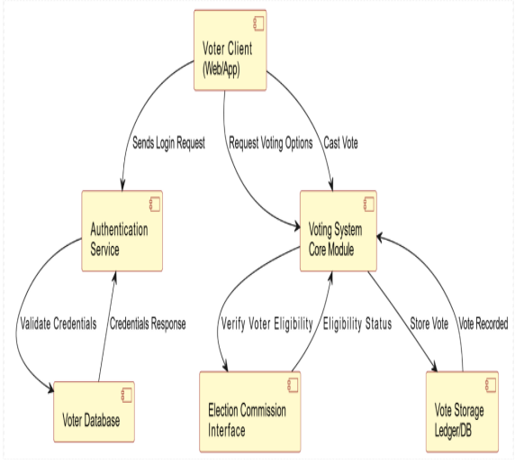
Component Diagram

Slide 16
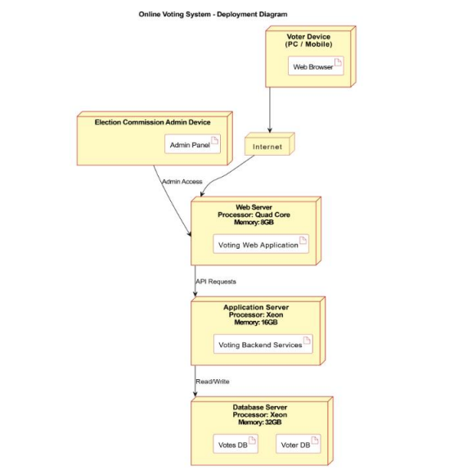
Deployement Diagram

Slide 17
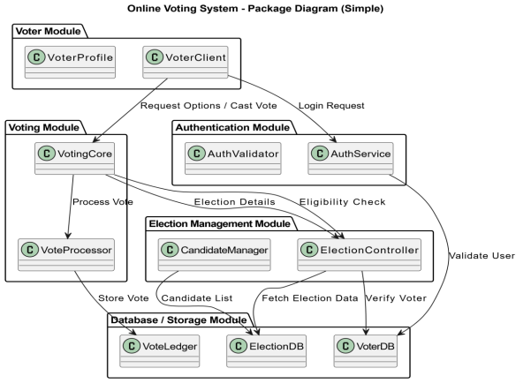
Package Diagram

Slide 18
Modules Description
1. User Registration & Authentication
Registers and verifies voters
Secures login using encryption
Provides role-based access
2. Candidate Management
Adds and updates candidates
Prevents duplicate entries
Displays candidate details

Slide 19
3. Voting Module
Allows secure voting
Restricts multiple votes
Stores encrypted votes
4. Result Calculation
Counts votes automatically
Generates accurate results
Supports result export

Slide 20
5. Admin Management
Controls system operations
Manages elections and users
Monitors system security

Slide 21
Implementation
Frontend: Built using Node.js with CSS for responsive design
Backend: Developed using Node.js API routes for handling application logic
Programming Language: Java Script is used for safer and cleaner code
Database: MongoDB is used to store the event of the System

Slide 22
Testing
User Authentication Test Case
Test Case ID | Test Scenario | Input | Expected Output | Actual Result | Status
UA01 | Valid User Login | Correct username and password | User successfully logged in and redirected to dashboard | Works as expected | Pass
Voting Module Test Case
Test Case ID | Test Scenario | Input | Expected Output | Actual Result | Status
VM01 | Cast Vote Successfully | Valid voter ID and candidate selection | Vote recorded successfully and confirmation message displayed | Works as expected | Pass

Slide 23
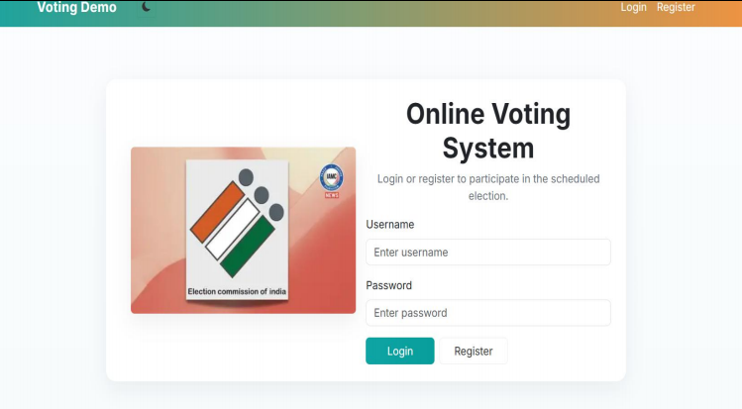
Output Screenshots
Login Page

Slide 24
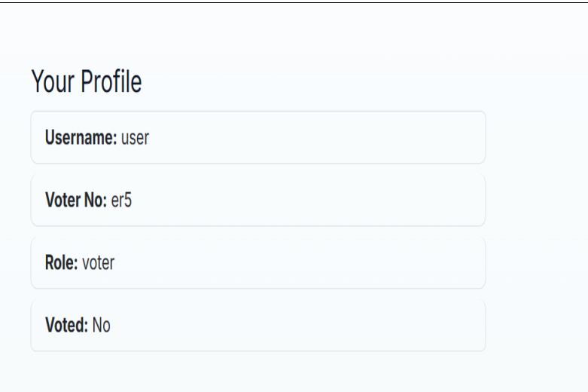
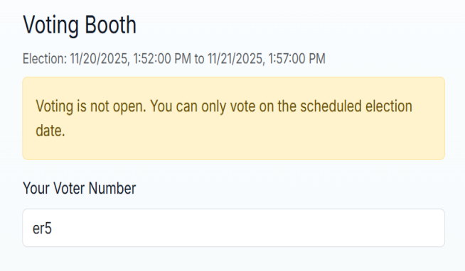
User Profile
Cast of Vote

Slide 25
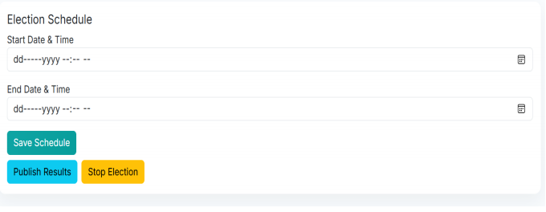
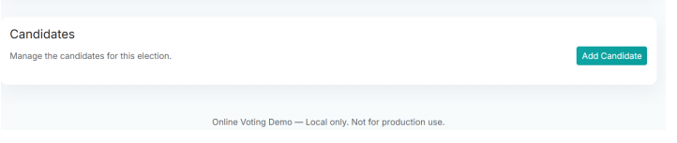
Admin login
Add or Delete Candidates

Slide 26
Conclusion and Future Enhancement
Conclusion
The Online Voting System provides a secure, efficient, and user-friendly platform for conducting elections.
It eliminates manual errors and reduces the time required for vote counting and result declaration.
Future Work
The system can be enhanced by integrating biometric authentication.
Mobile application support can be added to improve accessibility for users.

Slide 27


